Slide 1
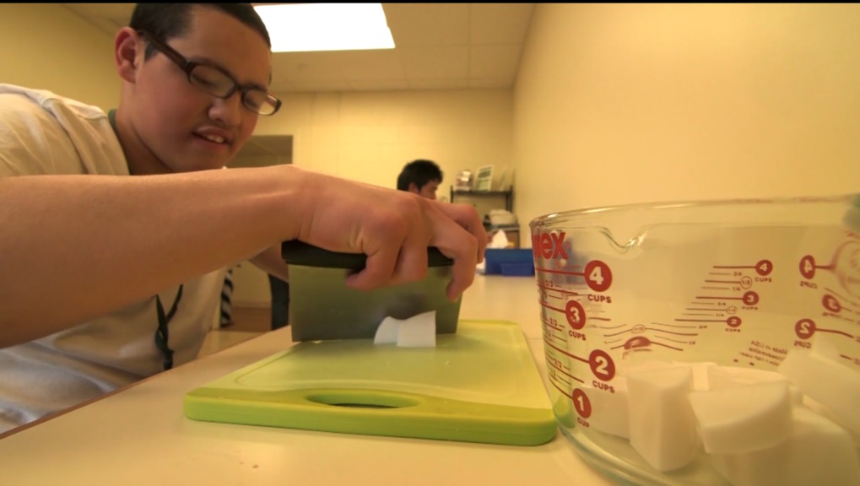
Autism and Visual Supports: Powerful Strategies for School, Home and the Community
Becky Remner M.S. CCC-SLP
(Director of Speech Language Pathology)
Lauren Williams M.A.CCC-SLP
(Assistive Technology Specialist)

Slide 2
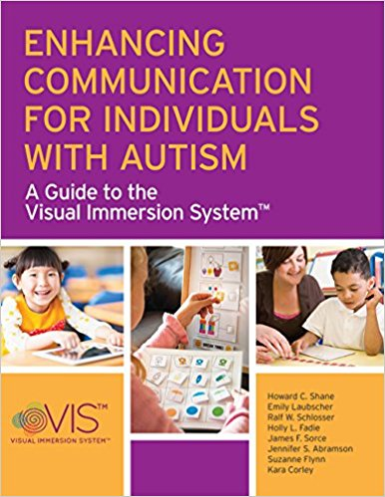
VIS is not a curriculum per se but a way to increase effectiveness of an existing curriculum, activity, or event by providing accessible language as an accommodation to improve comprehension and facilitate expression.
Visual Immersion System

Slide 3
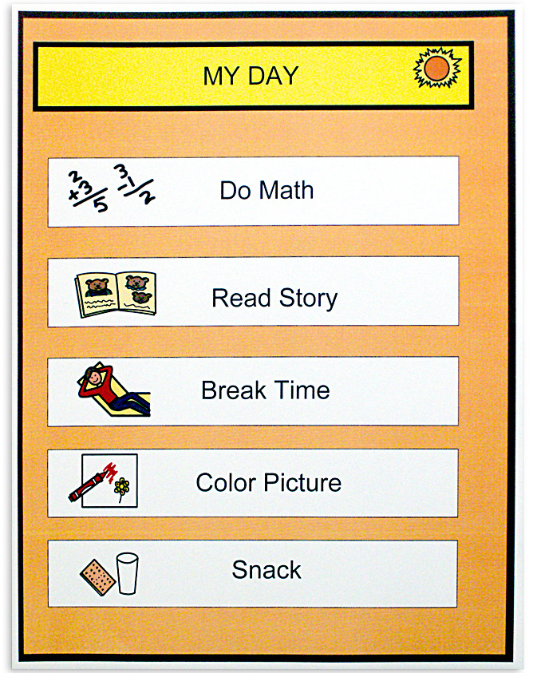
Visual Organizational Mode (VOM):
Visual cues used to represent the organization of an activity, routine, script, or schedule. These should not be thought of as a “crutch” from which they should be weaned.
Ex.: Schedule, timer, token board, first-then board, lists

Slide 4
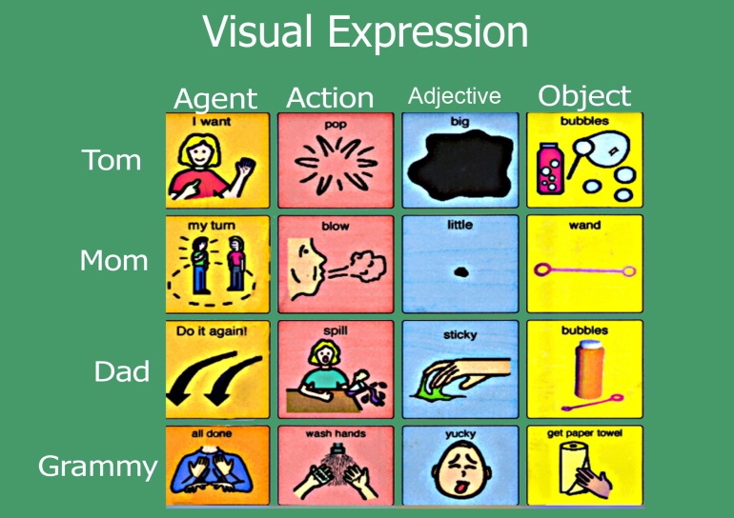
Visual Expressive Mode (VEM):
Visual cues used for
the purpose of expressive communication.
Ex.: Topic boards, AAC devices, PECS, scene displays.

Slide 5
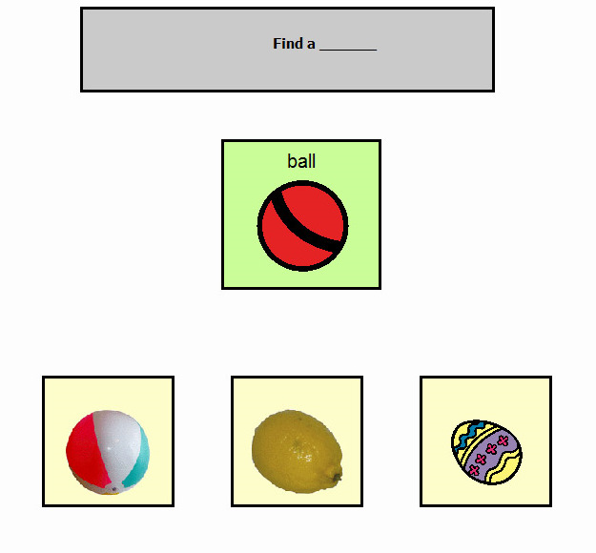
Visual Instructional Mode (VIM):
Visual cues used for the purpose of comprehension, that are imposed as an alternative to, or in conjunction with, speech.
Ex.: word wheels, flashcards, written directions, visual stories, any visual to aid in comprehension of concept or content.

Slide 6
Assessment
VRA-Visual Representation Assessment
Systematic way to determine whether a student needs real objects, real photographs, symbols, or text in order to comprehend visual information.
PACE-Preposition Action Concept Evaluation
Systematic way to determine which type of visual support (static or dynamic) the student needs in order to learn new skills across the curriculum.

Slide 7
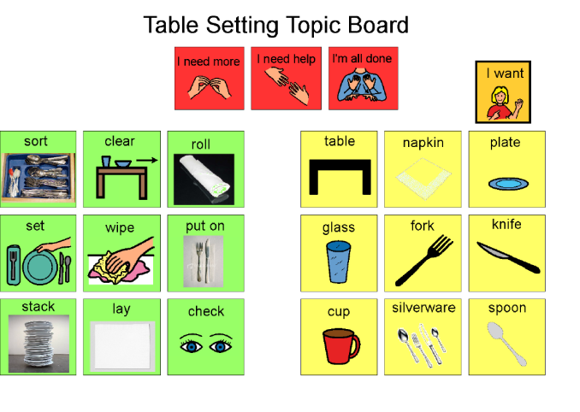
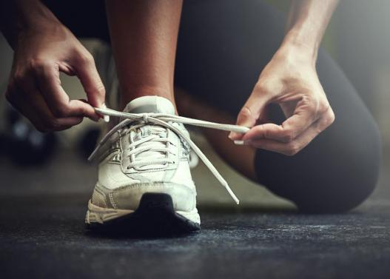
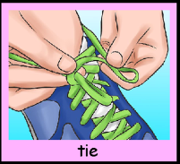
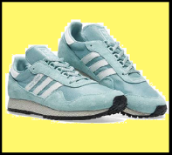
Communication Displays
Whole Scene Displays
Mixed Displays
Grid Displays
Communication book displays
Conversation displays
Visual schedules
Temporal displays

Slide 8
Case Example #1 Meet Thomas
Thomas is a multimodal communicator who primarily communicates through physical manipulation and contact with people to guide them toward/ bring to them what he wants to access and push away what he does not want. Thomas has been introduced to a communication book with photographs to exchange and high tech grid displays with real pictures, both of which have had limited success at this time.
Directives: . Thomas can follow basic, routine, one –step, contextualized directives (e.g. close the door, sit, stand, give me, and point) independently when he is attending to the task and provided gestural cues, but is unable to expressively regulate his environment using directives. Thomas functionally follows directives within the school environment with various levels of visual, gestural, partial physical, and verbal support from staff for novel and decontextualized directives.
Requesting: Thomas requests preferred objects and activities (i.e., iPad, snack, walk, bathroom, gross motor room ) with moderate-maximum prompting (verbal, gestural, physical). Thomas will occasionally request by physically prompting staff members to an object (e.g., open the classroom door, open the snack bin, or towards the door to go for a walk.)
Organization and Transitions: Thomas transitions throughout his school day with supports from staff (e.g., visuals depicting the location he is expected to go).
Protests/Refusals: Thomas will use his arm or a staff's hand to push objects away during structured and unstructured activities to convey refusal. Less adaptive signs of protest and unhappy emotions exhibited by Thomas include biting his hand, grabbing a staff's arm or hand and nail digging, and pulling staff's hair during less desirable structured and unstructured activities and demands (i.e., completing a table top task). He does not respond to yes/no questions independently at this time.
Comments: Thomas does not comment at this time. He does smile, laugh, and clap his hands, yell or attempt to push an item away to communicate like/dislike, which could be used for a basis for commenting in the future.
Questions: Thomas does not ask questions at this time and requires prompting to respond to questions regarding what he would like to earn.
Social Pragmatics: Thomas will hold staff members hands, or occasionally try to hug staff when he is observably happy. He will respond to his name by turning and looking in the general direction of the person calling his name in most opportunities. Thomas leads staff to the location of things he wants. His joint attention to a preferred activity is fleeting, although he enjoys sensory games, he consistently needs moderate-maximum prompting to continue the engagement with staff.

Slide 9
Assessment Results
VRA- *Thomas benefits from the use of real photographs
PACE- *Thomas benefits from the use of dynamic and static scene cues in order to supplement his shortcomings with verbal prompts alone
*student required adaptations and accommodations during assessment

Slide 10
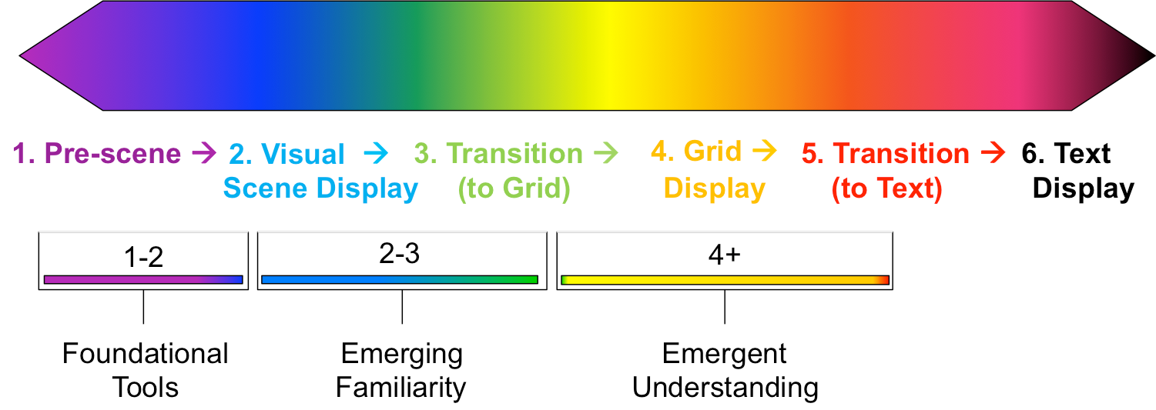
“Spectrum” of the Visual Immersion System
Real objects
Dynamic cues (i.e., videos)
Photographs and symbols combined
Static cues
Symbols

Slide 11
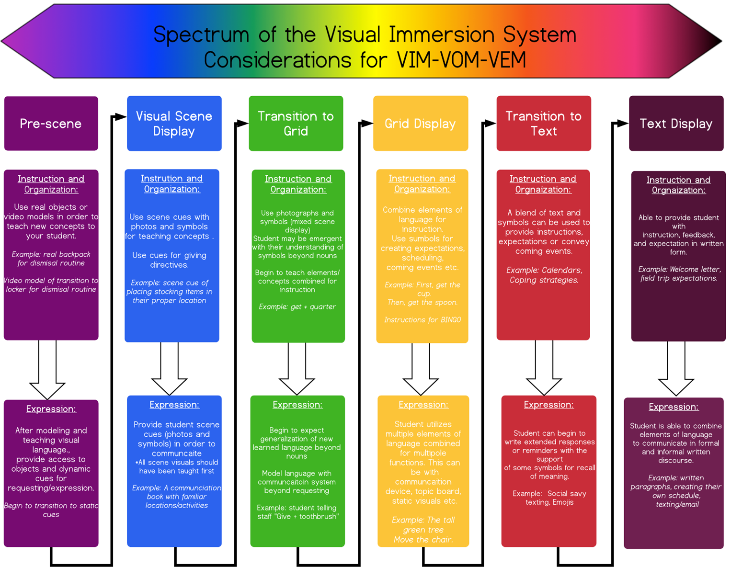

Slide 12
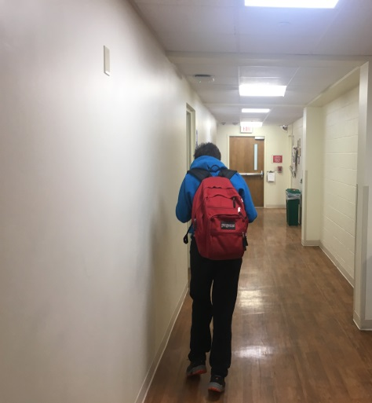
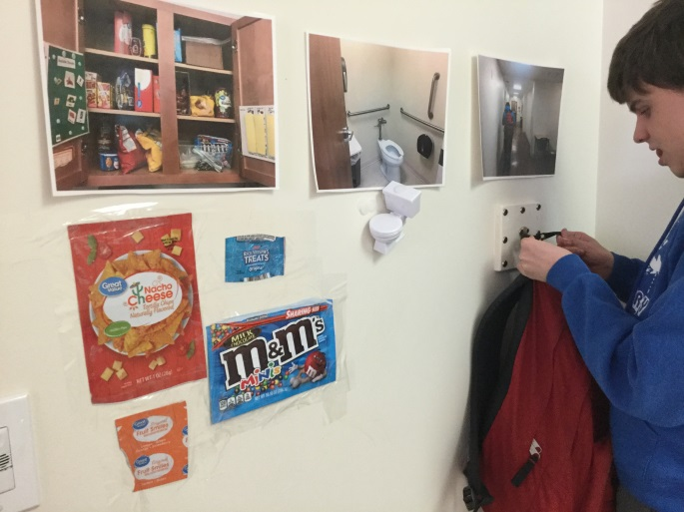

Slide 13
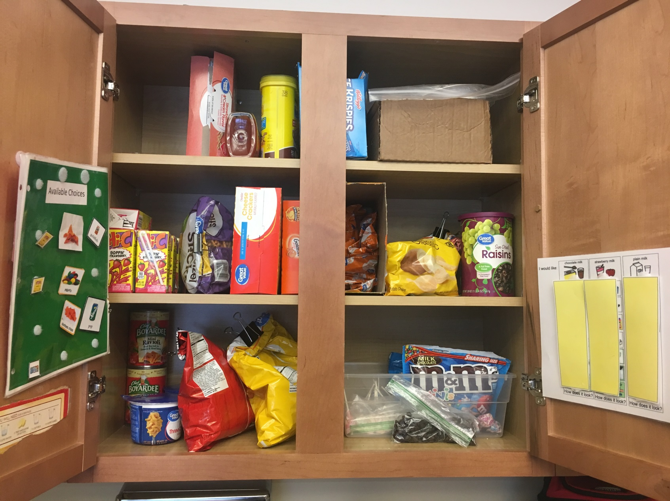
Visual Scene Display – Food Choices
Notes:
Cupboard at home

Slide 14
Case Example #2 Meet Bruce
Bruce is a 10 year old child uses total communication (vocalizations, visual scenes and symbols, gestures) to communicate his wants and needs. Bruce's current system of communication includes real photographs of items and large real photos of locations (scene cues). At this time, Bruce is able to independently request preferred food items and to go to the bathroom using Currently, Bruce is transitioning throughout his daily routine with minimum to moderate gestural and partial physical prompting. Bruce benefits from a second staff member being present each day during speech sessions in order to maintain safety during his activities and transitions and to allow for greater focus on communication and learning.
Protesting and Refusal -Bruce removes himself or pushes objects away to protest an non-preferred activity.
Organizing and Transitions- During transitions, Bruce is exposed to real photographs of locations (scene cues). When shown a scene cue, Bruce benefits from minimum to moderate cuing to transition to the location represented in the photograph. Bruce’s day is organized using real photos of items and activities that are relevant to his day.
Requests - Bruce uses total communication (pictures, gestures, physical manipulation) to request food, drinks, bathroom, preferred objects, and access to preferred locations(e.g. sensory room).
Directives-Bruce is able to follow one-step routine directives independently when actively participating in a session. At times, he benefits from minimum to moderate cueing to follow simple routine tasks. He is able to follow simple routine based directions when given contextual or visual cues (e.g. stand up, sit down, pick it up, put it down).
Comments – He does not currently use expressive comments at this time. Bruce uses vocalizations communicatively while sitting with peers or staff or while playing.
Questions – Bruce does not ask questions at this time and requires prompting to respond to questions regarding what he would like to earn.
Social Pragmatics -Bruce establishes interaction by using gestures paired with facial expressions, vocalizations, eye gaze, or physically manipulating his environment. Bruce has been observed holding staff members hands to show affection. With gestural prompts, Bruce uses picture symbols to interact with his peers during classroom group. Bruce will wave to peers when provided a model. During social groups Bruce has been improving his eye contact when giving a greeting or farewell to others.

Slide 15
Assessment Results
VRA- *Bruce benefits from the use of real photographs
PACE- *Bruce benefits from the use of dynamic and static scene cues in order to supplement his shortcomings with verbal prompts alone
*student required adaptations and accommodations during assessment

Slide 16
“Spectrum” of the Visual Immersion System
Real objects
Dynamic cues (i.e., videos)
Photographs and symbols combined
Static cues
Symbols

Slide 18
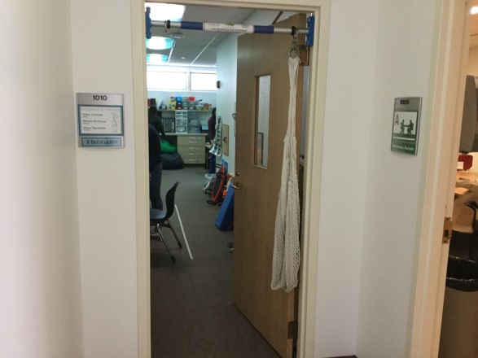
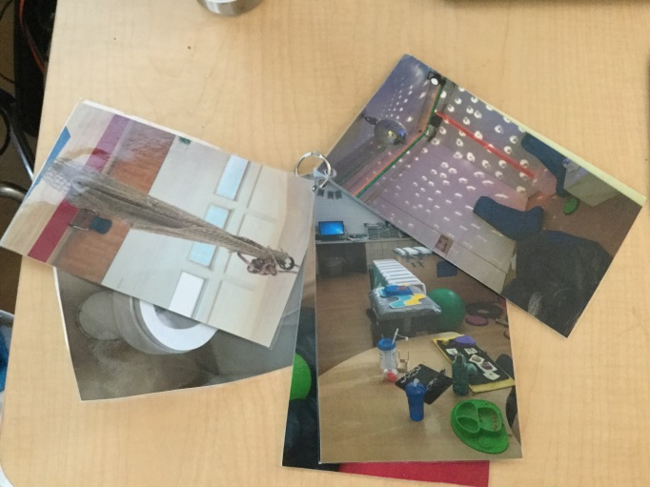
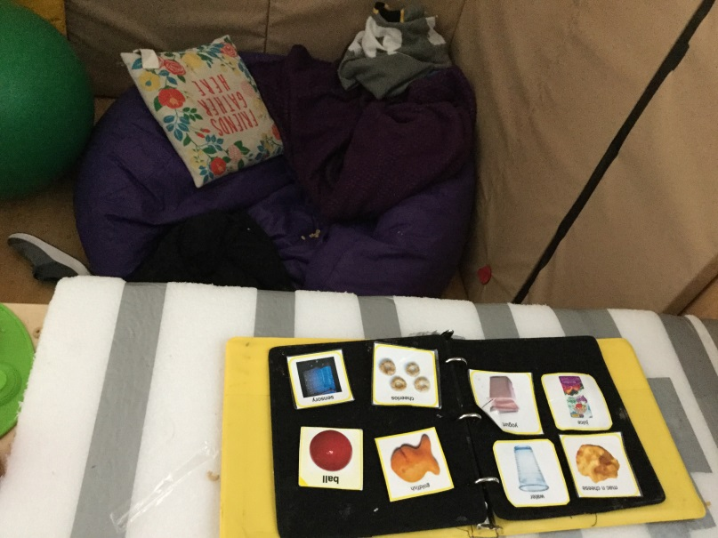
Notes:
Scene cues of car-how are we going to generalize this to home

Slide 19
Case Example #3 Meet Walter
Walter is a multimodal communicator who primarily communicates through his ipad with the application Touch Chat. He also knows limited sign language and uses gestures as well.
Directives: Walter demonstrates strength in his ability to receptively understand routine directives containing one to three steps (e.g., “Put the iPad on the desk, then sit down in the chair”). When provided with visual supports (e.g., Symbol Stix images), Walter is also able to follow novel directives that contain up to three visual language elements per step (with familiar verbs and nouns).
Requests: Walter continues to demonstrate strength in his ability to request reinforcing objects/activities (e.g., the iPad). He typically requests by using vocalizations (e.g., he will approximate the word “iPad”). When provided with a gestural or verbal reminder, Walter will request preferred objects using his talker. On his talker, Walter will oftentimes use a color modifier plus the object label to indicate what item he wants (e.g., [blue] + [iPad]; [black] + [iPad]). Walter is also beginning to request attention from others using "excuse me" and will use modified signs and/or his talker to request "help" when he needs a teacher to input the password to the computer.
Organization/Transitions: The organization of Walter’s day (i.e., his macro schedule) is visually presented to him using both symbolic and real pictures. He places the icon for the current session on his token board as well as the icon for his chosen reinforcement. When the session is finished, he places the icon in the "all done" column in his binder. A written visual schedule is used to label each activity as well as how many trials Walter is expected to complete for that activity. Walter ensures that each trial is marked off as his completes it by pointing.
Protests/Refusal: Walter’s protests appear to occur most frequently when transitioning off of technology to a less desirable activity (e.g., describing pictures). This frustration appears to decrease when sessions are highly structured and include high-interest activities (e.g., video modeling, Vizzle). Walter is most successful when provided with a written or visual schedule that contains either a timer or the number of trials that Walter needs to complete before moving to the next activity.
Questions Walter currently asks questions about unfamiliar objects or activities by gesturing, pointing, or tapping the object or symbol for that activity. Walter has not yet mastered interrogative reversal (i.e., moving the question word to the beginning of a sentence followed by the question contents). He continues to make his intent clear by repeating his method of asking when his question is not answered (e.g., tapping the visual again when a response is not given). Walter is currently able to answer familiar yes/no questions (e.g., “Do you like to swim?” or “Do you want the iPad?”) by using his talker to indicate “yes” or “no.” His receptive understanding of various WH-questions (e.g., who, what, when, where, why) has been improving throughout the past school year.
Comments: Walter continues to comment on his surroundings by gesturing towards objects of interest with his index finger, tapping on another person, and/or labeling objects. When given minimum prompting, Walter is also able to combine familiar modifiers or verbs with a noun in order to comment on something in his environment. For example, when playing on the blue iPad, Walter will use his talker to say “[blue] + [iPad].”
Pragmatics: Walter continues to successfully greet others by waving or approximating a verbal “hi” by making the /h/ sound. He continues to successfully say farewell to other people by approximating a verbal “bye.” If Walter is pre-occupied with another activity or task, he may need a verbal reminder to respond or initiate social greetings. Walter also demonstrates strength in his ability to initiate and sustain appropriate eye contact with someone when requesting and commenting. He continues to establish joint attention with other individuals by tapping them and pointing to an object of interest. The classroom staff have been provided with visuals to prompt Walter to use his talker to say "excuse me" in order to gain the attention of staff or peers. He will make intermittent eye contact with the person and smile at them when engaged in the highly-preferred activity.

Slide 20
Assessment Results
VRA- Walter can comprehend all levels of visual support
PACE- Walter learns best when introduced to new material via dynamic videos which are then faded to static scenes with elements.

Slide 21
“Spectrum” of the Visual Immersion System
Real objects
Dynamic cues (i.e., videos)
Photographs and symbols combined
Static cues
Symbols

Slide 23
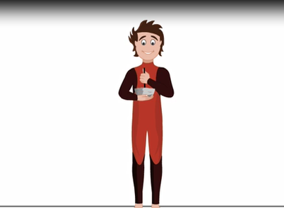
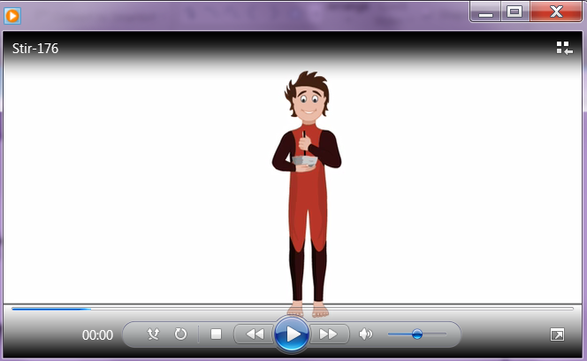
Dynamic Vs. Static

Slide 24
Mixed Scene Cue

Slide 26
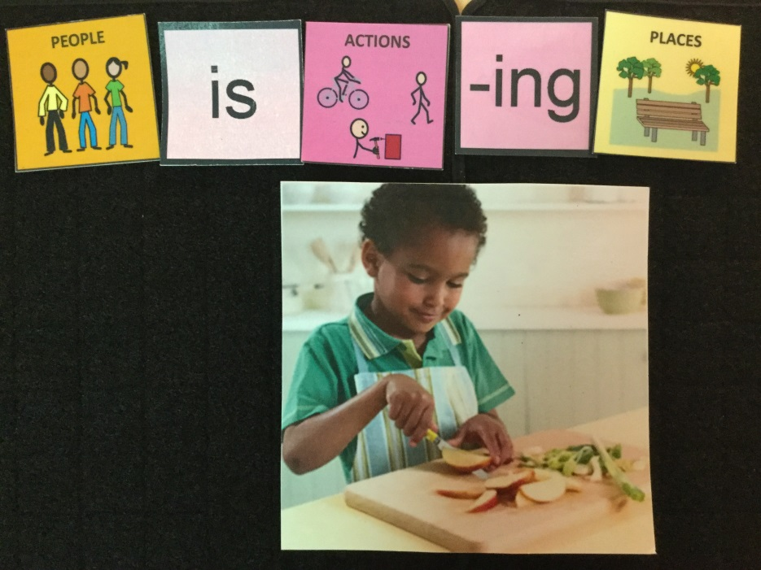

Slide 27
Case Example #4 Meet Tony
Tony is an energetic and kind young man with an excellent imagination. He uses verbal and non-verbal (i.e. gestures, facial expression) language to interact with staff and peers across activities during his school day. Throughout his school day Tony uses spoken language primarily to request, protest/refuse, comment, and to ask questions to staff. Tony’s primary mode of communication is spoken language and primarily consists of a mixture of scripted and spontaneously generated words, phrases, and sentences across a variety of task demands, with a variety of staff, within multiple environments. He demonstrates strengths in areas of: vocabulary associations, using simple sentences, and following a written schedule. Expressively, Tony continues to generate a variety of simple sentences to gain attention and answer questions related to pictures and video discussion. He benefits from visual supports and graphic organizers to provide additional information and details. Receptively, Tony demonstrates strengths in categorizing and identifying attributes.
Directives: Tony can follow a variety of multi-step directions in a routine within his current environment. In addition, Tony can follow one step novel directions within the classroom environments.
Requesting: Tony uses speech or gestures to request preferred items (e.g. iPad, snack), people, affection, attention, assistance, and information. Tony also unexpectedly requests, "Can I touch (a person's belly)?, or "Can I play with her?"
Organization and Transitions: Macro and micro visual schedules, “first-then” boards, white boards with written expectations, and guided access (timer) on the iPad are used to support Tony's comprehension.
Protests/Refusals: Tony will use a variety of protests to avoid non-preferred tasks and activities, and to push away undesired items.
Comments: During transition and free time, Tony will often approach staff to comment and share information about pictures, scenes from movies playing on a classroom iPad or a movie or music video scenes he currently is thinking about.
Questions: Tony verbally answers "Who-is" questions related to classroom peers, staff members or task material, "What-action" questions to visual or verbal stimuli, "Where is" questions with object retrieval, gesturing, or verbal responses. In addition, he answers inferential questions related to feelings and emotions.
Social Pragmatics: Tony demonstrates interest and is more skillful interacting with adults rather than his peers. He exhibits deficits pertaining to: answering more abstract questions, asking questions about others, understanding and taking turns to communicate, expanding on more diverse topics of conversation, and understanding boundaries and physical proximity in social spaces. Socially, Tony enjoys participating in conversations with staff in 1:1 or 1:2 settings. He independently initiates conversations and greets peers and staff throughout his day. When provided with visual supports and topic boards, Tony is able to formulate on-topic follow-up questions during staff conversations. He benefits from visual supports and topic boards for asking questions and making comments during conversations. He continues to benefit from gestural support as a reminder for nonverbal communication. Tony experiences difficulty with the nonverbal aspects of conversation such as using appropriate eye contact and body language, and maintaining personal space. He benefits from verbal and visual cues for increased comprehension, interpretation and use of nonverbal aspects of communication (i.e. proximity, posture, gestures, eye contact) during conversations. He continues to work on applying these skills in conversations with a variety of peers and staff within the middle school- high school.

Slide 28
Assessment Results
VRA-Tony can comprehend all levels of visual support
PACE- Tony has the capacity to utilize any combination of dynamic, static and text based visual supports for instruction of new material.

Slide 29
“Spectrum” of the Visual Immersion System
Real objects
Dynamic cues (i.e., videos)
Photographs and symbols combined
Static cues
Symbols

Slide 31
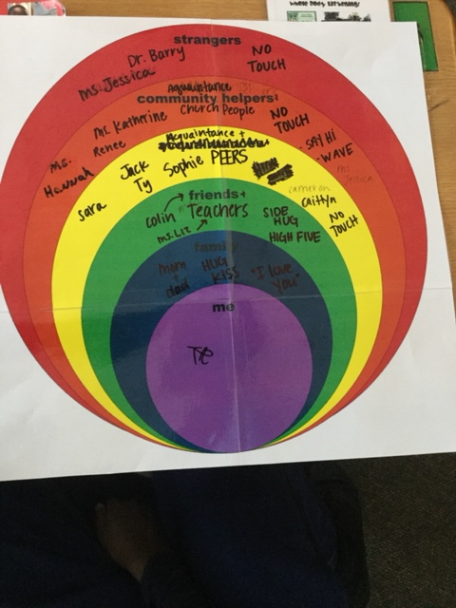

Slide 32
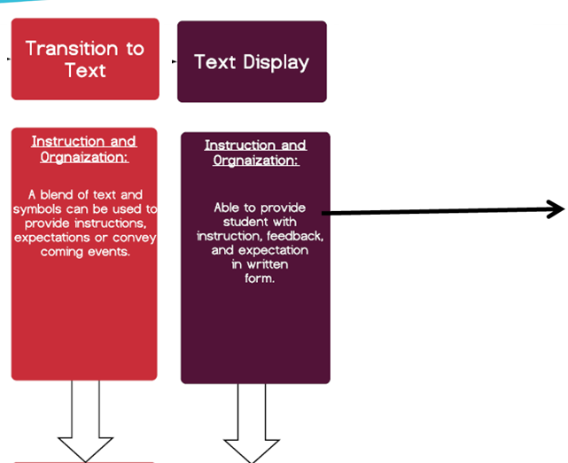
Math Case Example

Slide 33
Static Scene Cue

Slide 34
Static Scene Cue

Slide 35
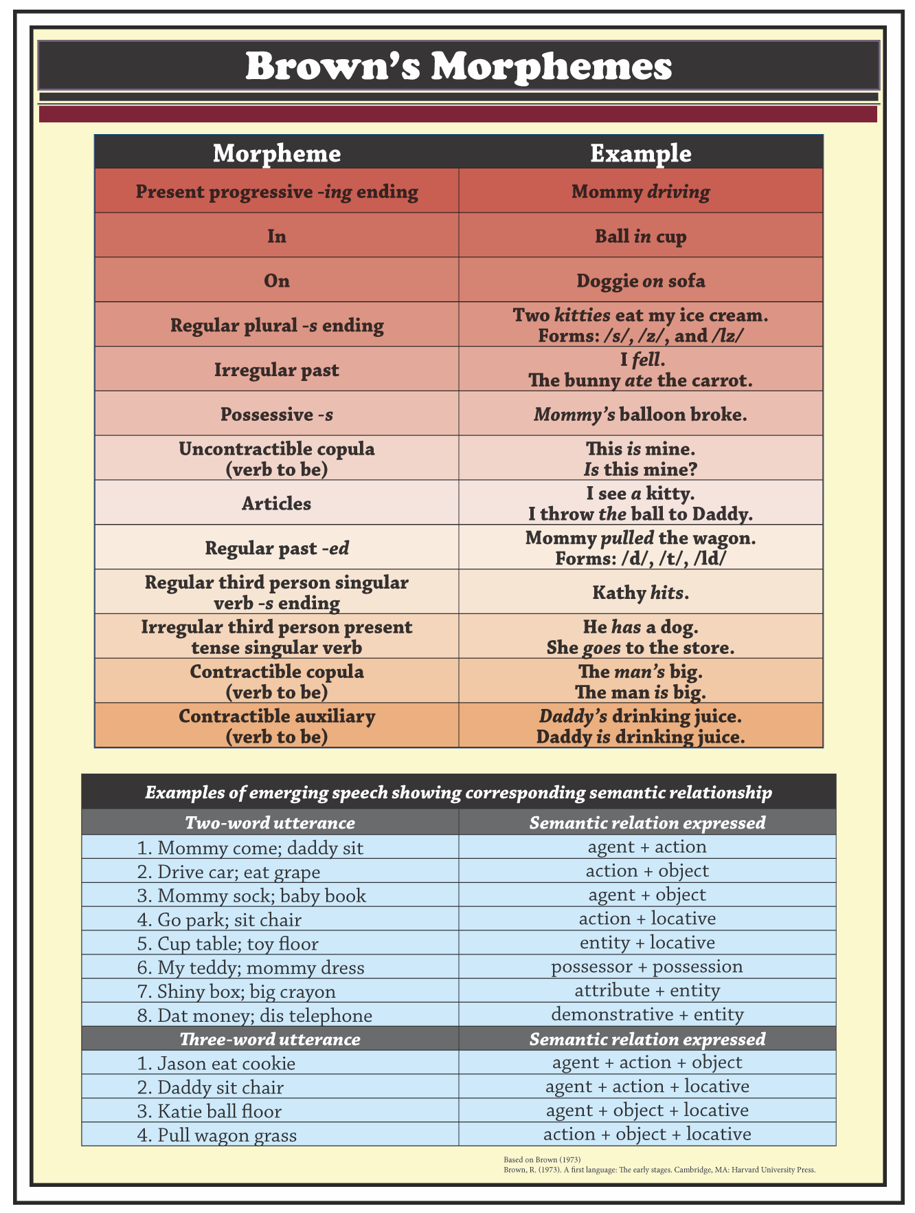

Slide 36
Types of Element Cues
Agent Element Cues
Object Element Cues

Slide 37
Types of Element Cues
Action Element Cues
Spatial Element Cues

Slide 38
Types of Element Cues
Attribute Element Cues
Temporal Element Cues

Slide 39
Mixed Scene Cue

Slide 41
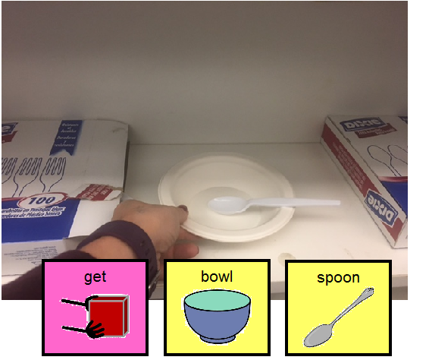
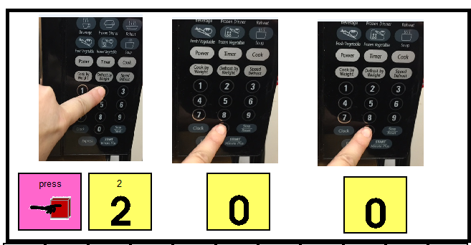

Slide 42
Why Video-Based Observational Learning?
Takes advantage of the learner’s
Visual processing capability over auditory processing
Provides a variety of different behaviors in realistic contexts
Use multiple familiar people, objects, and settings
Efficient and cost-effective
Create once, replay as many times as needed
Consistency is built-in
Students with autism favor viewing themselves in videos
Self-modeling

Slide 43
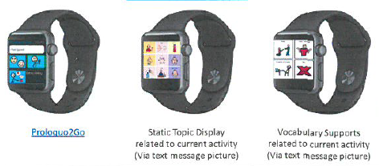
Video Modeling (Dynamic Scene Cues)
A method of teaching that uses video recordings or live video to provide a video model of instructions on how to carry out a task, behavior, or skill.
Four types of video modeling
Basic: a video filmed of someone other than the viewer of the video performing a task or skill
Self-Modeling: the video is of the viewer performing the task or skill
Point of View: video is recorded from the point of view of the viewer
Video Prompting: consists of multiple steps to break down the task. Either the viewer or someone else can be the subject.

Slide 44
Review
Assessment is key! Don’t skip this step!
Remember, even though a child is using a grid format, new skills should be introduced with static or dynamic scenes.
Move children along the visual spectrum as appropriate, but meet them where they are.

Slide 45
Questions?

